Slide 1

SQL PROJECT ON PIZZA SALES

Slide 2


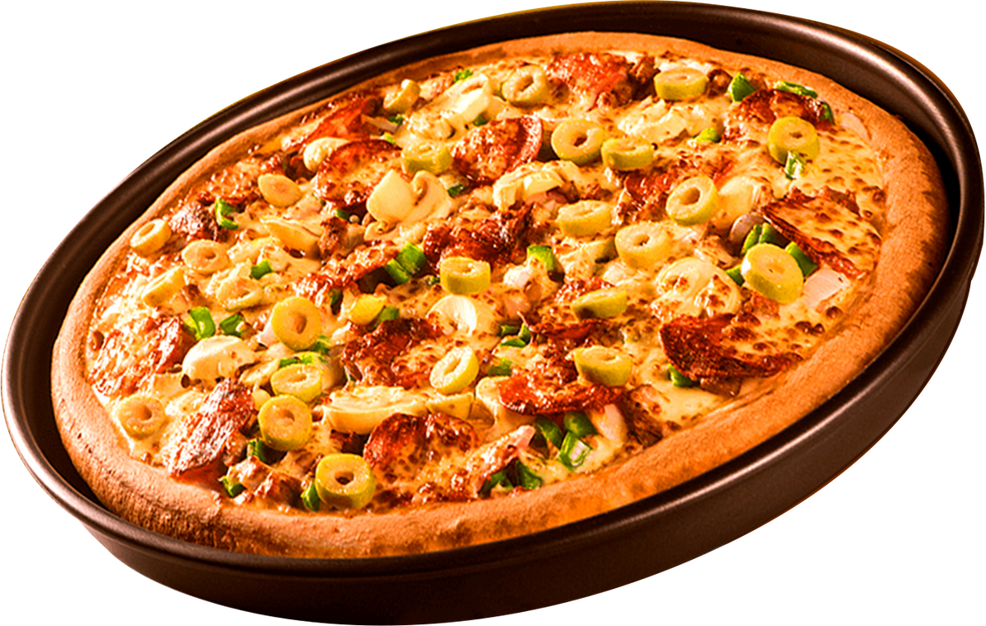

HI
My name is rajesh i learned sql after that i completed a sql project
on pizza sales.Here i can analyse the basis of data and find some
valuable insights of sales. That’s helps to know the how much sales,
category wise pizza type, pizza size category etc.Frist start the solve
some basics question after intermediate and advanced question.
Here i took it four tables to analysis

Slide 3
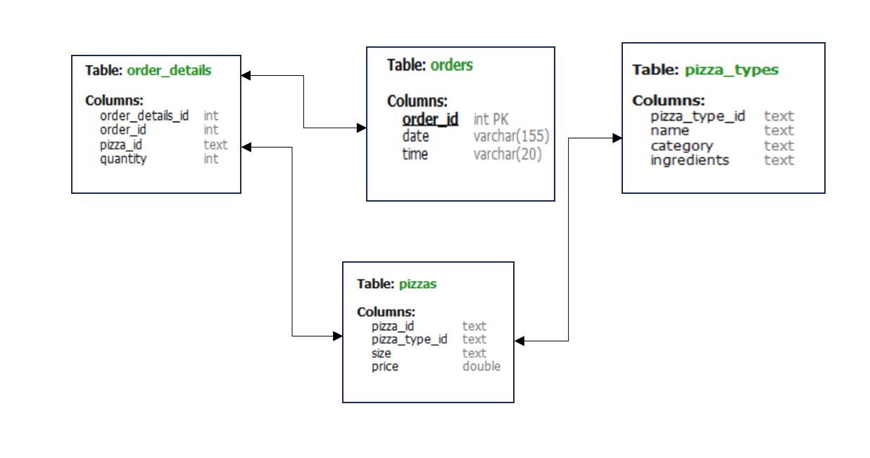
DATA SCHEMA

Slide 4
BASIC QUESTION

Slide 5
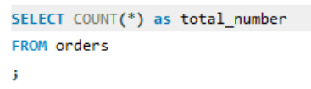
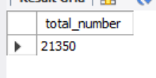
RETRIEVE THE TOTAL NUMBER OF ORDERS PLACED

Slide 6
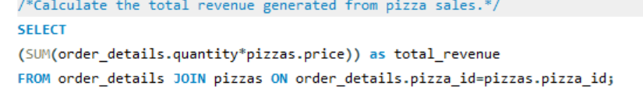
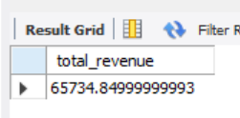
CALCULATE THE TOTAL REVENUE GENERATED FROM PIZZA SALES

Slide 7
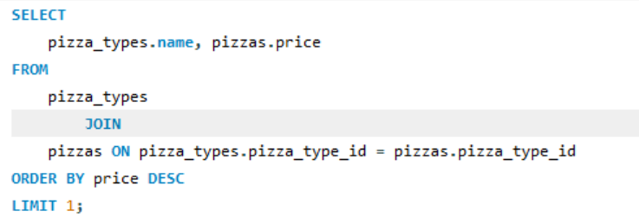
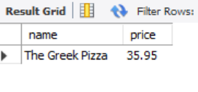
IDENTIFY THE HIGHEST-PRICED PIZZA

Slide 8
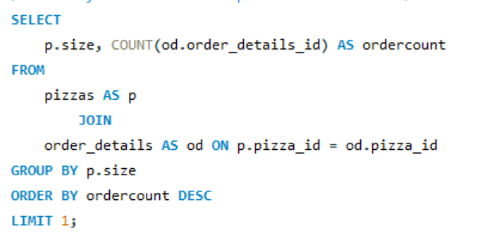
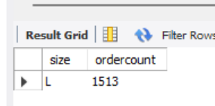
IDENTIFY THE MOST COMMON PIZZA SIZE ORDERED.

Slide 9
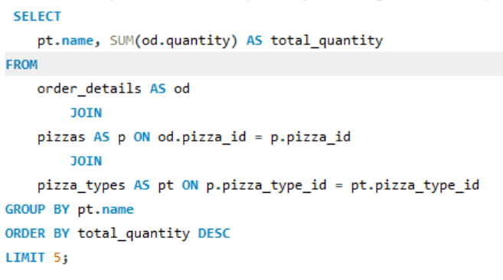
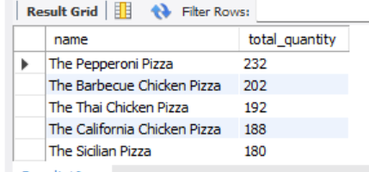
LIST THE TOP 5 MOST ORDERED PIZZA TYPES ALONG WITH THEIR QUANTITIES

Slide 10
INTERMEDIATE
QUESTION

Slide 11
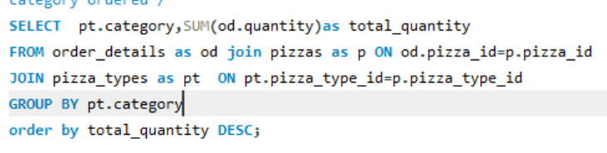
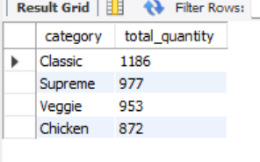
JOIN THE NECESSARY TABLES TO FIND THE TOTAL QUANTITY OF EACH PIZZA
category ordered

Slide 12
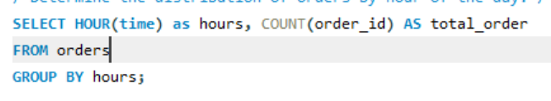
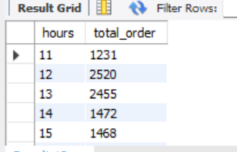
DETERMINE THE DISTRIBUTION OF ORDERS BY HOUR OF THE DAY

Slide 13
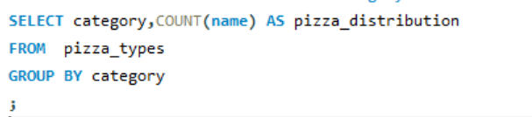
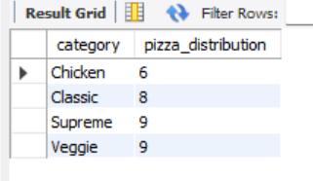
JOIN RELEVANT TABLES TO FIND THE CATEGORY-WISE DISTRIBUTION OF PIZZAS

Slide 14
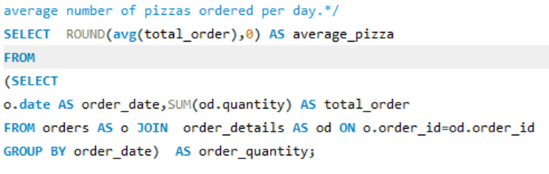
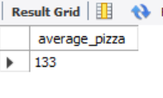
GROUP THE ORDERS BY DATE AND CALCULATE THE
average number of pizzas ordered per daY

Slide 15
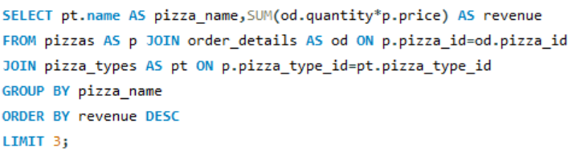
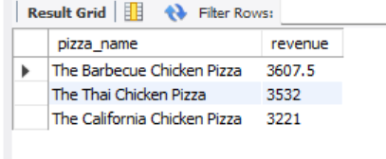
DETERMINE THE TOP 3 MOST ORDERED PIZZA TYPES BASED ON REVENUE

Slide 16
ADVANCE
QUESTION

Slide 17
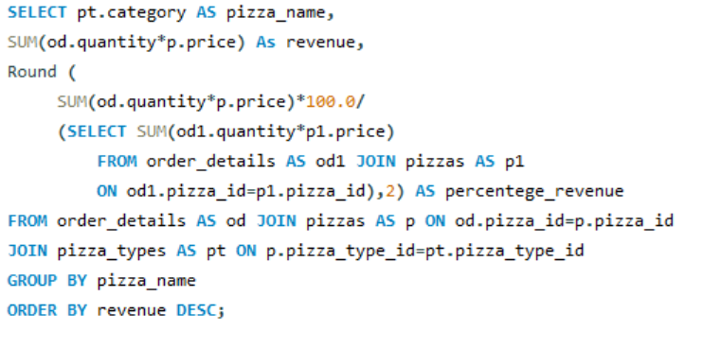
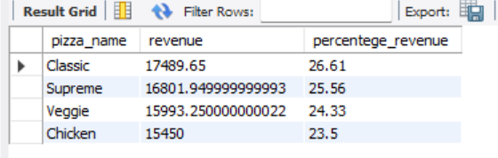
CALCULATE THE PERCENTAGE CONTRIBUTION OF EACH PIZZA TYPE TO TOTAL REVENUE

Slide 18
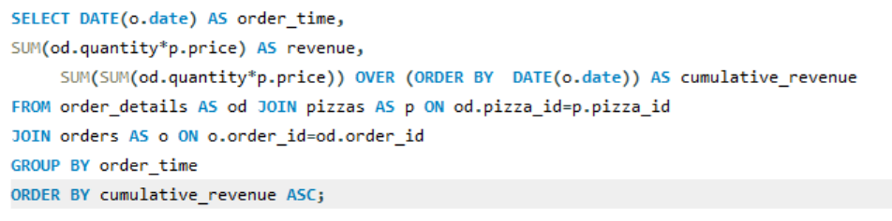
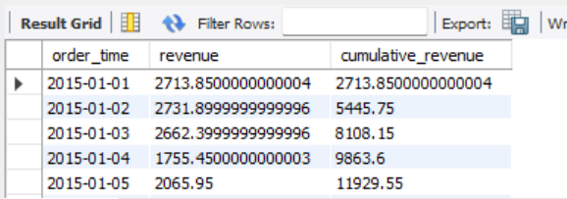
ANALYZE THE CUMULATIVE REVENUE GENERATED OVER TIME

Slide 19
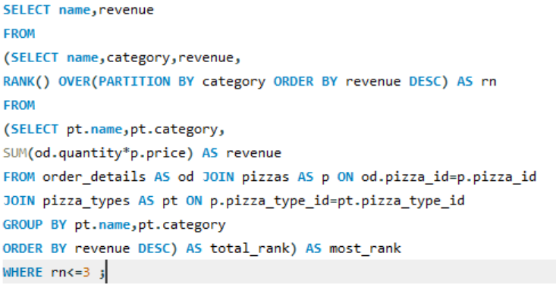
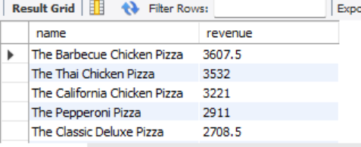
DETERMINE THE TOP 3 MOST ORDERED PIZZA TYPES BASED ON REVENUE FOR EACH PIZZA CATEGORY

Slide 20





contact
rajeshsantra9696@gmail.com
Rajesh Santra
GituserRajesh

Slide 21
thank you!

